Slide 1
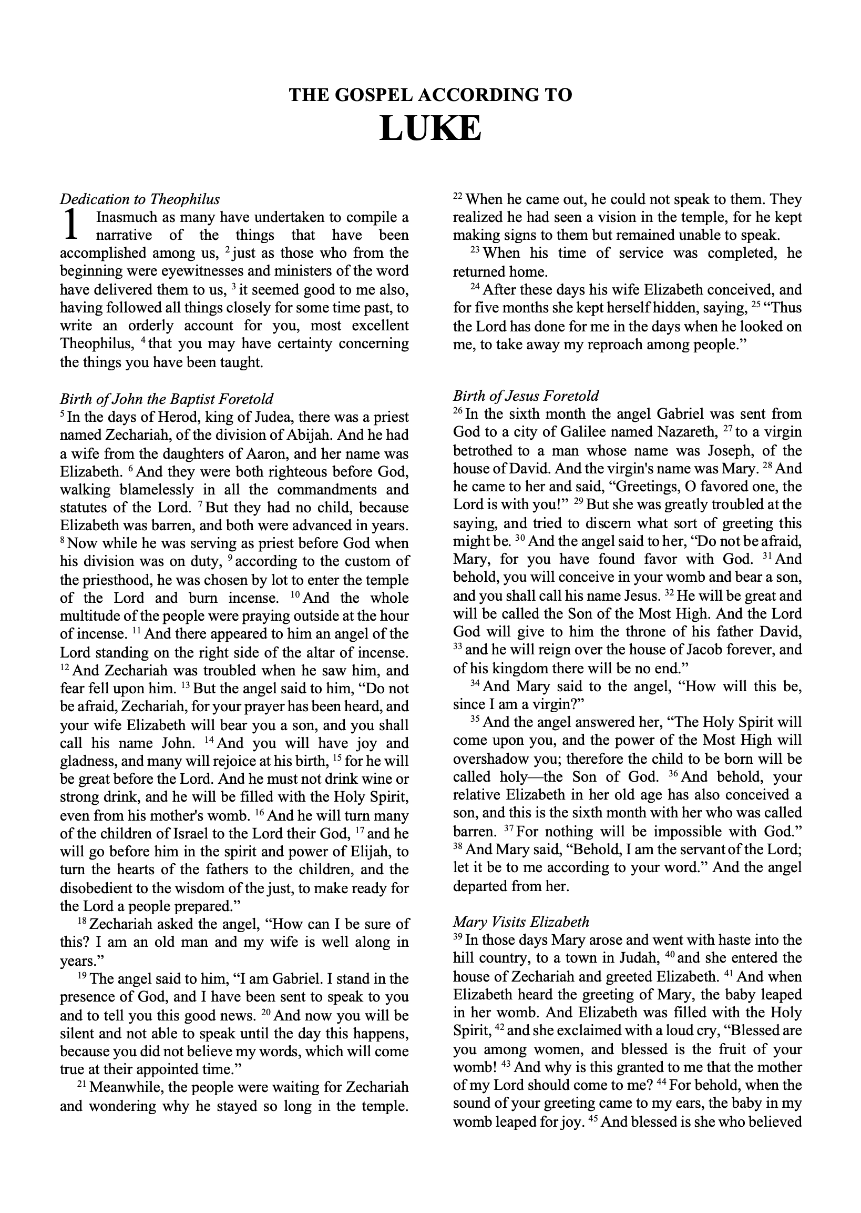
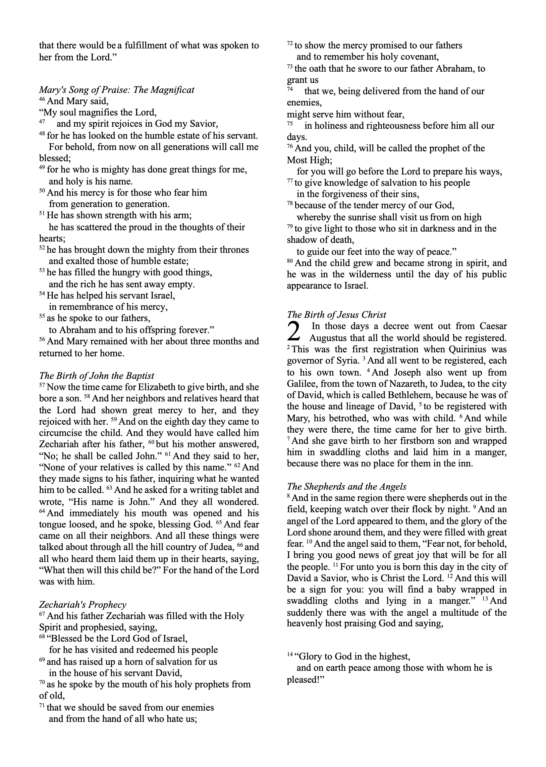
3rd Sunday in Ordinary Time
Jan. 24: John the Baptist
4th Sunday of Advent
Christmas (Midnight)
Dec. 8: Immaculate Conception, Dec. 12: Our Lady of Guadalupe
4th Sunday of Advent

Slide 2
Dec. 22
3rd Sunday in Ordinary Time
Jan. 24: John the Baptist
Dec. 19
4th Sunday of Advent
Mar. 25: Annunciation
Dec. 20
Christmas (Midnight)
Dec. 23
Jan. 24: John the Baptist
Dec. 8: Immaculate Conception, Dec. 12: Our Lady of Guadalupe
4th Sunday of Advent
Dec. 21
Aug. 15: Assumption
Dec. 24

Slide 3
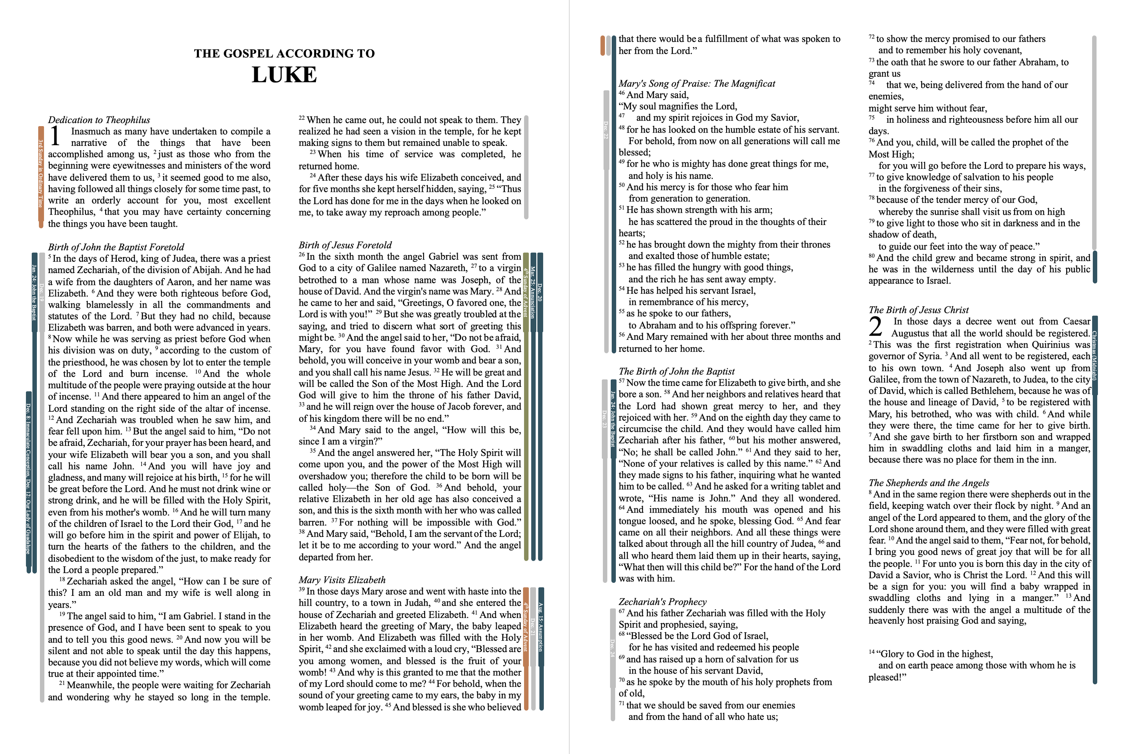

Slide 4
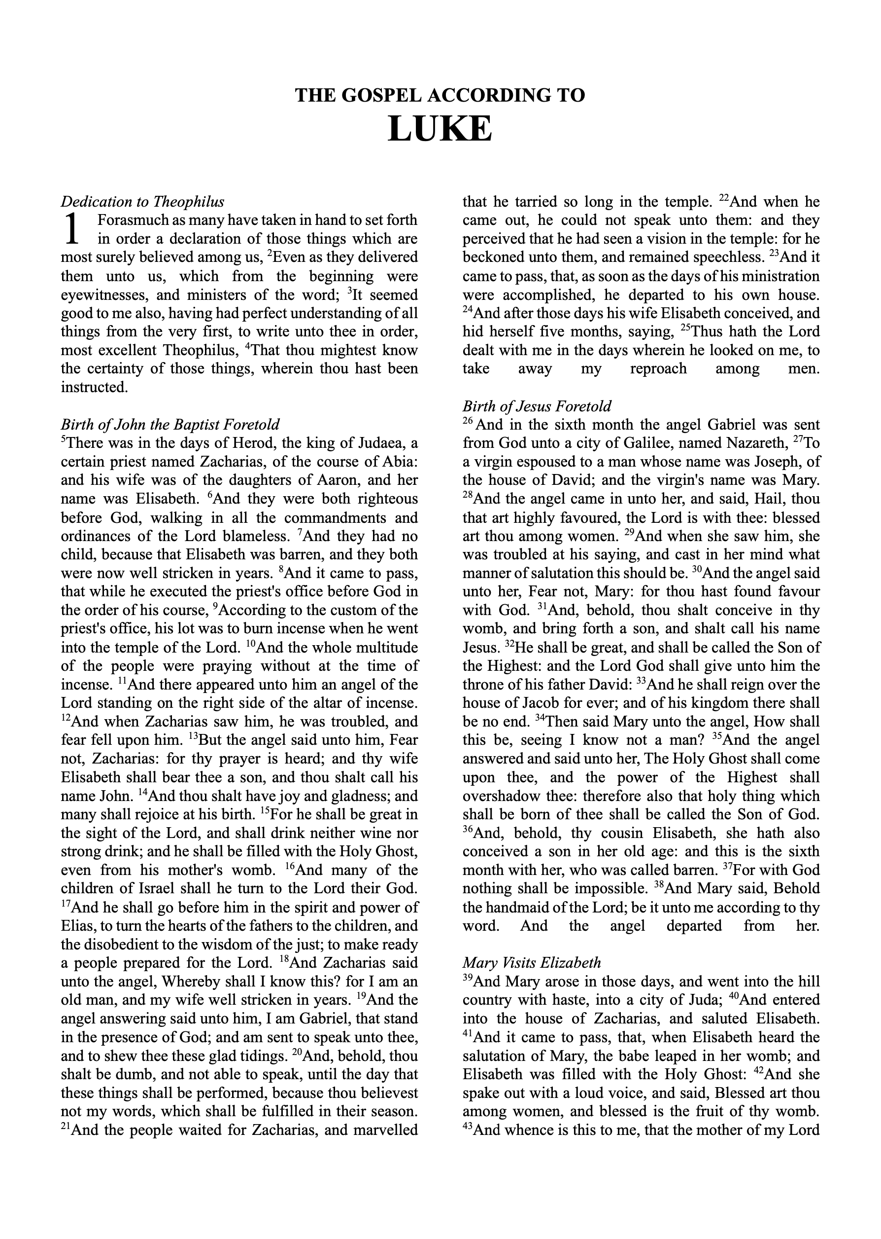
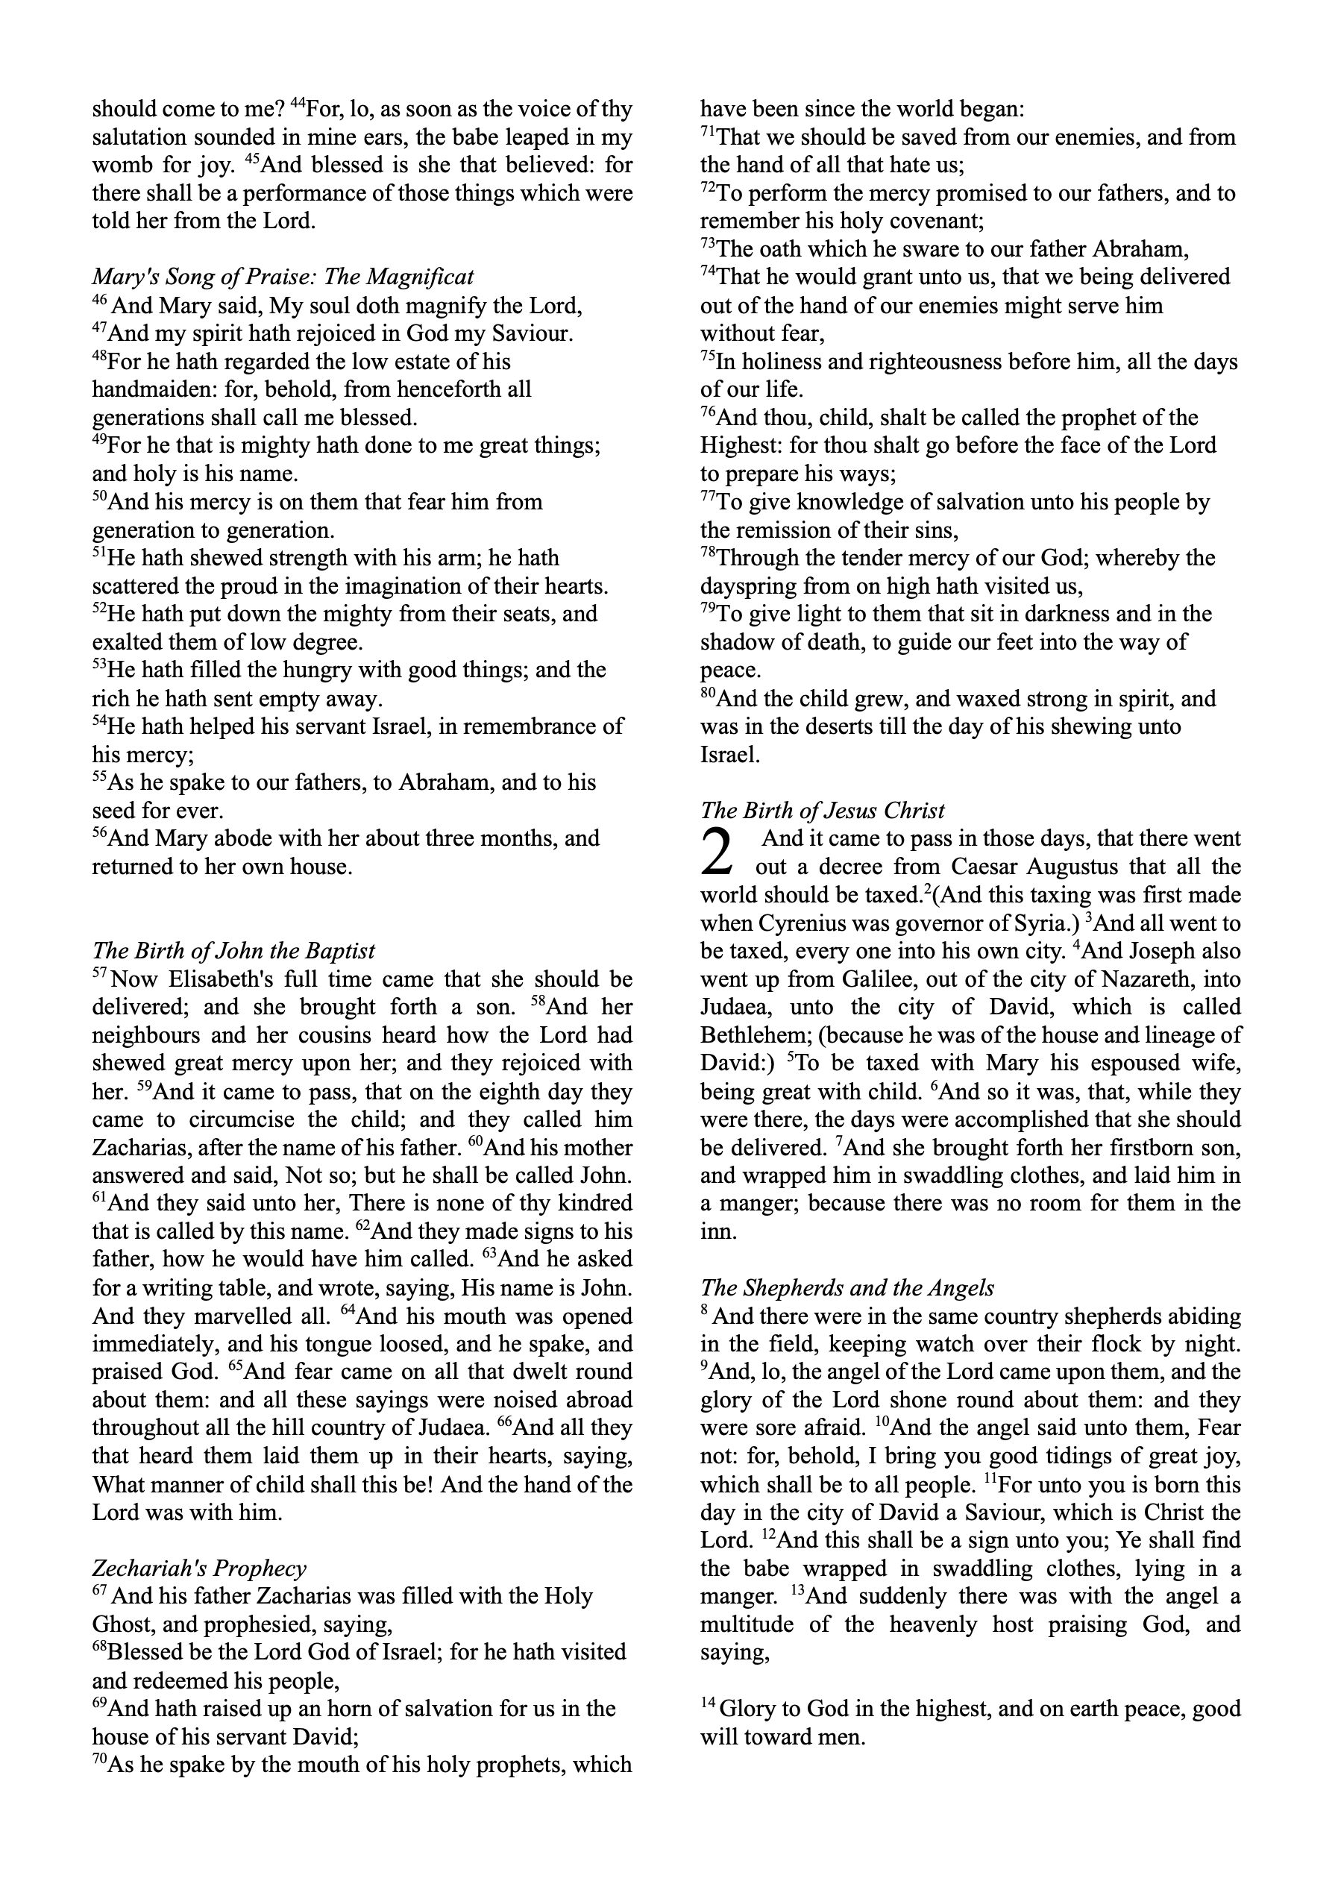
KJV
Dec. 22
3rd Sunday in Ordinary Time
Dec. 19
4th Sunday of Advent
Mar. 25: Annunciation
Jan. 24: John the Baptist
Dec. 20
Christmas (Midnight)
Dec. 23
Jan. 24: John the Baptist
Dec. 8: Immaculate Conception, Dec. 12: Our Lady of Guadalupe
4th Sunday of Advent
Dec. 21
Aug. 15: Assumption
Dec. 24

Slide 5
KJV-c
Dec. 22
3rd Sunday in Ordinary Time
Dec. 19
4th Sunday of Advent
Mar. 25: Annunciation
Jan. 24: John the Baptist
Dec. 20
Christmas (Midnight)
Jan. 24: John the Baptist
Dec. 23
Dec. 8: Immaculate Conception, Dec. 12: Our Lady of Guadalupe
4th Sunday of Advent
Dec. 21
Aug. 15: Assumption
Dec. 24

Slide 6
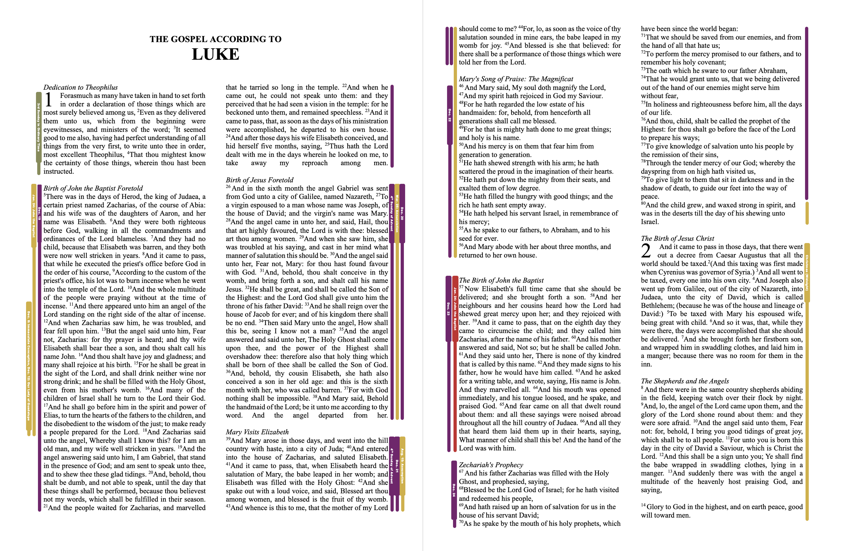
KJV

